Slide 1

16-19 APRIL 2013
DURBAN ICC

Slide 2

APD306
MVVM in XAML
Mark Pearl
Developer Coach
Driven Software

Slide 3
Join the DeveloperUG
Monthly user group meetings & workshops
Range of topics, from code to technologies
Join the user group at www.DeveloperUG.org.za

Slide 4
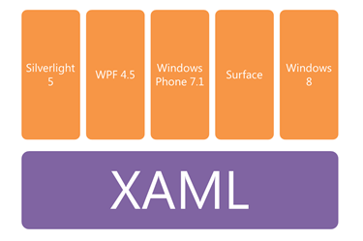

Who is this targeted towards
XAML Based
Level 200 Session
https://github.com/MarkPearl/TechEd2013_MVVM.git
Notes:
People new to the MVVM pattern. If you are a hardened MVVM’er, this session is probably not for you.
WPF
Silverlight
WinRT
HTML?

Slide 5
Agenda
Why MVVM
High Level View
XAML Core Concepts
Solution Structure

Slide 6
Agenda
Maintainability?
MVVM Frameworks / Toolkits?
Wrap Up

Slide 7

Why MVVM?

Slide 8


In the past…
Notes:
Show Application development in the past
Tightly coupled to business logic
Hard to change
Doesn’t support multiple simultaneous workflows
Hard to test

Slide 9

Where we want to be…
Notes:
UI Design Pattern
Plumbing code separated from domain
Easy to test
Developer / Designer simultaneous workflow

Slide 10
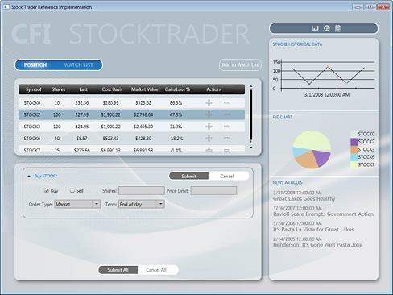
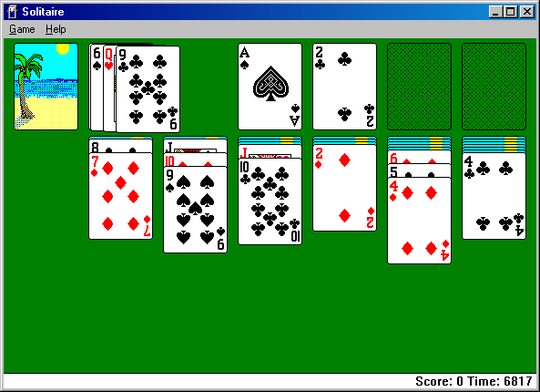
Who’s it for?
Business Applications
Game Development

Slide 11

HIGH LEVEL OVERVIEW

Slide 12




M
V
VM
Model
View
View Model

Slide 13

View
Concerned with visual elements
XAML Based
Doesn’t care about the rest of the system
No code behind

Slide 14


ViewModel
Gofer of the pattern
Non visual classes
Testable & independent of the view
Implements change notifications

Slide 15

Model
Non visual classes
Has no knowledge of View or ViewModel
Client side domain

Slide 16
M
VM
V
Model
View Model
View
Portable
Platform - specific

Slide 17

XAML Core Concepts

Slide 18
Things to understand…
Notes:
Data Binding
DataContext / Binding
INotifyPropertyChanged
ObservableCollection
Commands
ICommand
Behaviours
Attached Properties
Attached Behaviours
Converters
IValueConverter
MarkupExtension

Slide 19

Things to understand…
Data Binding
Notes:
Data Binding
DataContext / Binding
INotifyPropertyChanged
ObservableCollection
Commands
ICommand
Behaviours
Attached Properties
Attached Behaviours
Converters
IValueConverter
MarkupExtension

Slide 20
DATA BINDING

Slide 21
Data Binding
Set the Data Context
Bind via XAML expression
Objects bound to implement INotifyPropertyChanged & ICollectionChanged interfaces

Slide 22

Things to understand…
Data Binding
Commands
Notes:
Data Binding
DataContext / Binding
INotifyPropertyChanged
ObservableCollection
Commands
ICommand
Behaviours
Attached Properties
Attached Behaviours
Converters
IValueConverter
MarkupExtension

Slide 23
Commands
Model
View Model
View

Slide 24
COMMANDs

Slide 25
Commands
Used for trigger actions from the view
Expose property in ViewModel implementing ICommand interface
Use Delegate Commands or Inject ViewModel

Slide 26

Things to understand…
Data Binding
Commands
123 =
Converters
Notes:
Data Binding
DataContext / Binding
INotifyPropertyChanged
ObservableCollection
Commands
ICommand
Behaviours
Attached Properties
Attached Behaviours
Converters
IValueConverter
MarkupExtension

Slide 27
Converters
No UI Specific References
Model
View Model
View
10101010
10101010
Color

Slide 28
CONVERTERS
123 =

Slide 29
Converters
Converts data to visual representation
Implements the IValueConverter interface
Easy way to create them is inherit the MarkupExtension Class

Slide 30

Things to understand…
Data Binding
Commands
123 =
Converters
Behaviours
Notes:
Data Binding
DataContext / Binding
INotifyPropertyChanged
ObservableCollection
Commands
ICommand
Behaviours
Attached Properties
Attached Behaviours
Converters
IValueConverter
MarkupExtension

Slide 31
ATTACHED BEHAVIOURS

Slide 32
Behaviours
Helps us keep View and ViewModel clean
Use code snippet to get started
Strategy to avoid code behind

Slide 33
Things to understand…
Data Binding
Commands
123 =
Converters
Behaviours
Notes:
Data Binding
DataContext / Binding
INotifyPropertyChanged
ObservableCollection
Commands
ICommand
Behaviours
Attached Properties
Attached Behaviours
Converters
IValueConverter
MarkupExtension

Slide 34

Solution Structure
Notes:
Project Strucutre
ViewModel / View Folders
ViewModelBase
Wiring Views to ViewModels
ViewModel First Approach
View First Approach

Slide 35
Folders & Naming Conventions
Folder for View and folder for ViewModel
View = [Name + View]
ViewModel = [Name + ViewModel]
i.e. PersonView & PersonViewModel

Slide 36
What creates what…
View Model First Approach
View First Approach
Notes:
Data Binding
DataContext / Binding
INotifyPropertyChanged
ObservableCollection
Commands
ICommand
Behaviours
Attached Properties
Attached Behaviours
Converters
IValueConverter
MarkupExtension

Slide 37

MVVM MAINTAINABILITY
Notes:
Unit Tes

Slide 38

MVVM Maintainability
Unit Testing
Notes:
Unit Testing
Structuring for DI
Inversion of Control Pattern is closely related to Dependency Injection
Unit Testing
Separation of concerns should make things easier to test
Code that touches UI elements may not behave predictably when run from unit tests
Write unit tests for ViewModel methods that have branching
Use Dependency Injection to remove tightly coupled dependencies
Effective unit testing is an art, beyond the scope of this session

Slide 39



Frameworks / Toolkits
PRISM 4
Notes:
Prism
Caliburn Micro
MVVM Light

Slide 40
Don’t forget….
To rate this session!
WHERE?? CommsNet area Windows8 App Windows Phone www.teched.co.za
To download the content of this session on www.MyTechEd
To check out our app/info boards for Competitions

Slide 41



Review
Why MVVM
Core Concepts
Solution Structure
Maintainability
Notes:
Why MVVM
Separation of Concerns
Fundamental Concepts
Binding, Commands, Behaviors, Converters
Solution Structure
View First, ViewModel First approach
Maintainability
Unit Test, Structuring for DI
Available Toolkits
Prism, Caliburn Micro, MVVM Light

Slide 42

Questions

Slide 43
Contact Me
MarkP@DrivenSoftware.com
blog.MarkPearl.co.za
@MarkPearlCoZa

Slide 44
Offers
Are you developing a Windows Phone app? Need a developer account we can help you out
Need to test your applications? Why not book some time in our lab. We have Windows 8 and Windows Phone devices and someone on hand to assist you.
Contact us via our blog / facebook / twitter

Slide 45
Don’t forget….
Follow us on Twitter - @msdevsa
Join our Facebook group – www.facebook.com/msdevsa
Our blog – http://blogs.msdn.com/southafrica

Slide 46

© 2011 Microsoft Corporation. All rights reserved. Microsoft, Windows, Windows Vista and other product names are or may be registered trademarks and/or trademarks in the U.S. and/or other countries.
The information herein is for informational purposes only and represents the current view of Microsoft Corporation as of the date of this presentation. Because Microsoft must respond to changing market conditions, it should not be interpreted to be a commitment
on the part of Microsoft, and Microsoft cannot guarantee the accuracy of any information provided after the date of this presentation. MICROSOFT MAKES NO WARRANTIES, EXPRESS, IMPLIED OR STATUTORY, AS TO THE INFORMATION IN THIS PRESENTATION.

